Slide 1
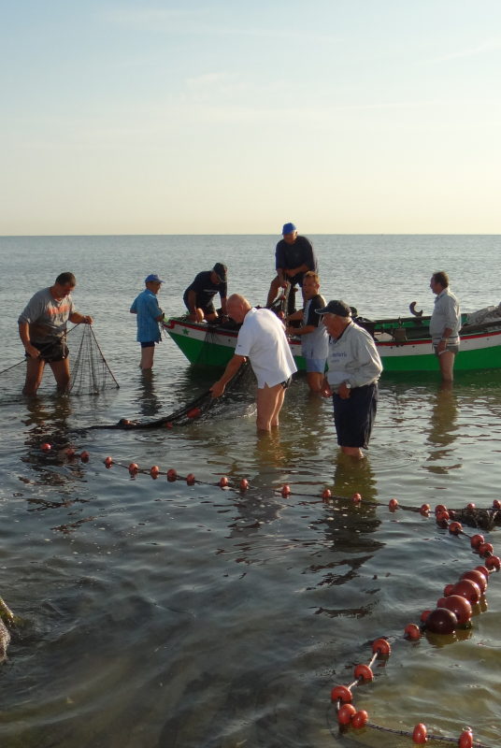
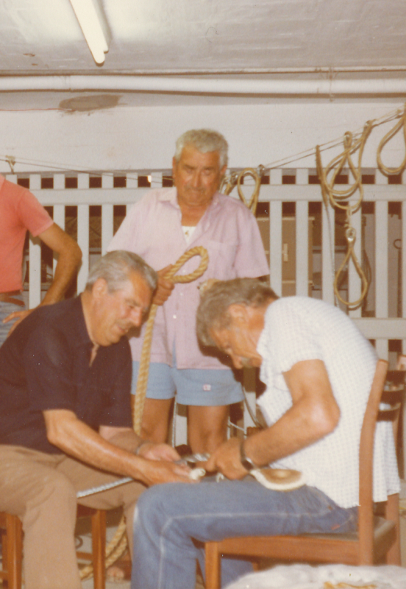
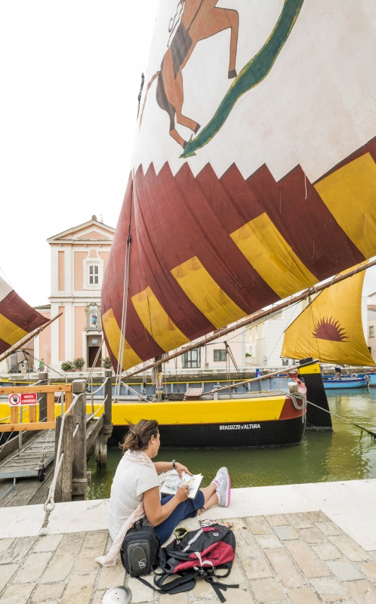
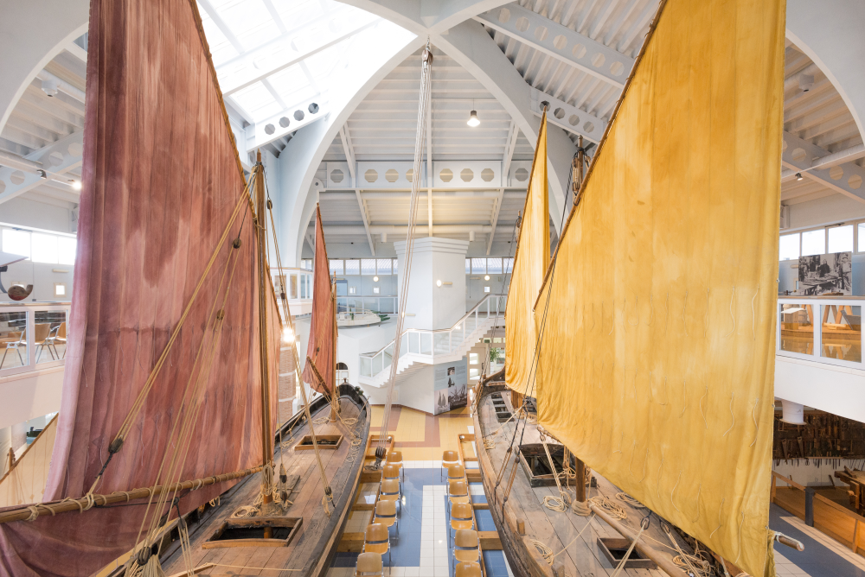
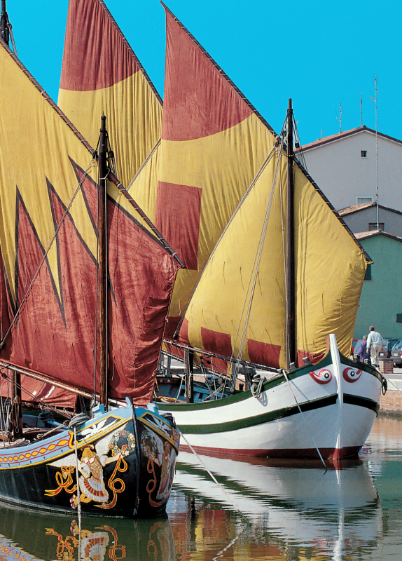
Davide Gnola:
museum director & curator & c.
The scope of our museum is…
- to preserve and show tangible/intangible heritage of Adriatic seafaring (fishing, little coastal transport)…
- to be a safeguard and an interpretation centre in order to protect and valorize coastal history, culture, environment, so giving an help to contrast banalisation and exploitation of the coast
We have a link with ICH because…
- the Museo della Marineria was born thanks to the rediscovered intangible heritage (crafts, skills, sailing techniques, etc.) which permitted to save and recover tangible heritage too (boats, objects, etc.)
mainly by means of sailing traditional boats, museum can promote and inspire actions to know, preserve and valorize our maritime intangible heritage (sailing, old fishing techniques, maritime skills, cooking, festivals, social relations)

Slide 2
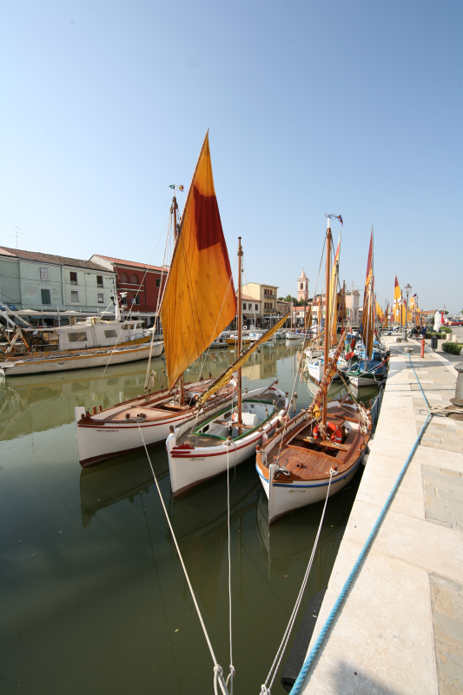
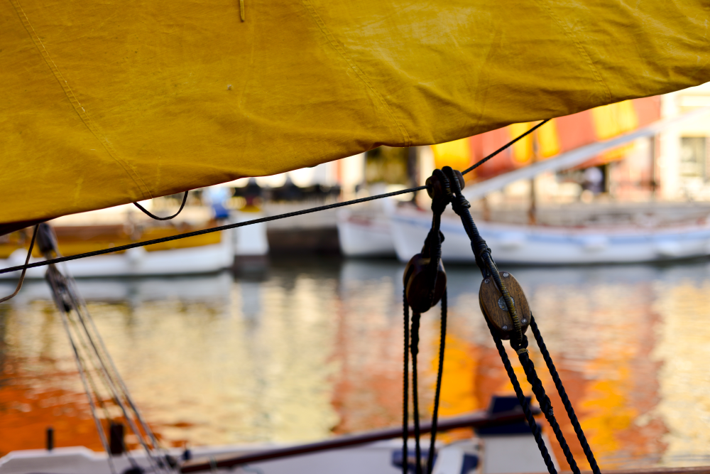
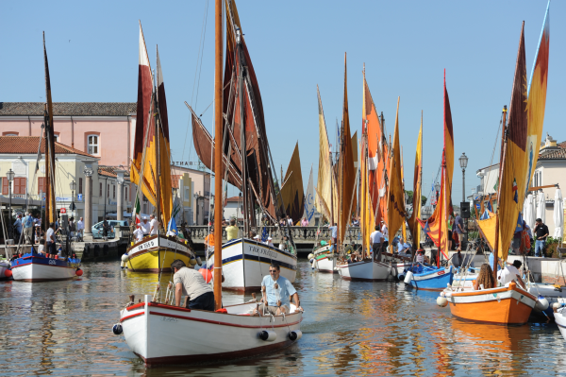
“Boats at its own home”: the mooring area reserved to traditional boats in the historical harbour
The museum inspired the Municipality to reserve to Adriatic traditional boats belonging to private people a mooring area in the historical channel port, next to its historical sailing boats; and also elaborated the rules to admit them (typology, well maintenance, rigging, prescriptions like to hoist sails in summer and take part to meetings and festivals).
The project was sure a good idea to preserve and highlight local maritime “look” and heritage, but it gained also a very important value for intangible maritime heritage, because the boat owners are mainly old fishermen, representing the living heritage of our town, and now they are always on the quays in front of their boats talking with people, citizens, tourists.
So in this way we are experimenting how a community can animate the port docks, by their presence and spontaneous activities, like sailings, fishing, fish cooking, etc.
Now this represent one of the more important asset we have in our town regarding maritime heritage, like a sort of “living section” of the Maritime Museum.
Notes:
Keywords: seafaring; maritime museums; traditional/historical boats/vessels; historical harbours; fishing

Slide 3
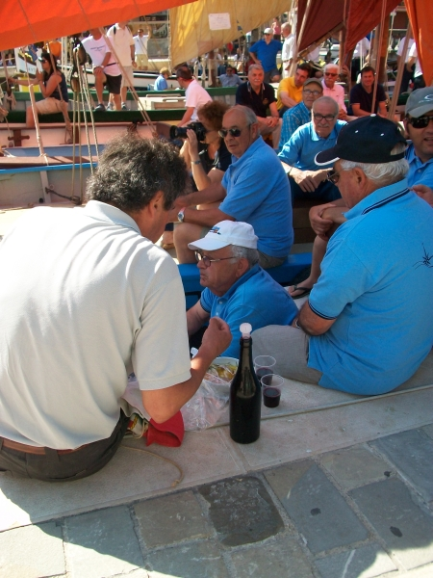
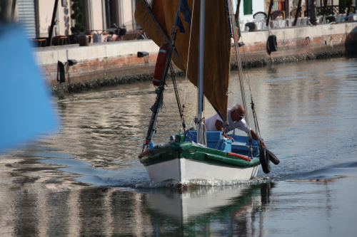
ICH, museums and diversity: the biggest challenge we encountered
The biggest challenge:
to explain to the old boats owners that it is not a project of the museum or Municipality, or a simple opportunity of mooring their boats, but a real opportunity to preserve and keep alive – together with their boats – the living heritage of their lives, experiences, memories, tales;
on the other side: try to explain that the project is not only a way to give a new look to the historical channel port, but the opportunity to gain a new idea of a sustainable tourism based on the respect and valorization of the local community and maritime heritage.

Slide 4
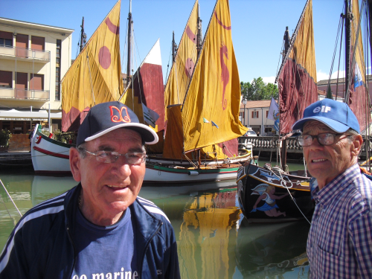
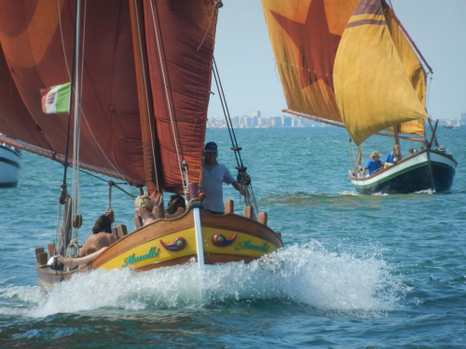
ICH, museums and diversity: win-wins?
The win-win situation: The project gave many important results on different aspects: 1) supporting private owners to keep alive and sailing boats that are important living witnesses of our maritime heritage; 2) requalifying and valorizing an important corner of the port/town; 3) creating a living and sailing “extension” of the museum; 4) supporting tourism promotion of the town not with improvised events, but by means of the preservation of local heritage.

